Slide 1
Introduction to the
Diodes-1
PN Junction, Zener, LED

Slide 2
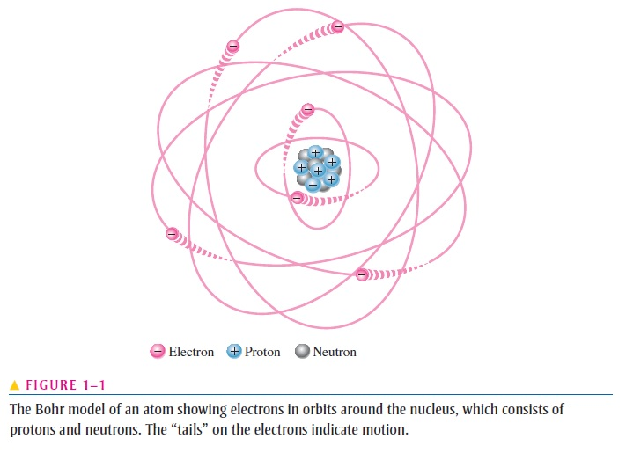
Recall Bohr Atomic Model

Slide 3
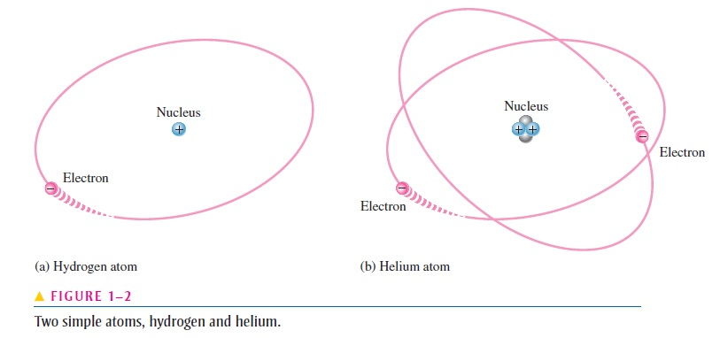

Slide 4
Insulator
Conductor
Semiconductor
An insulator is a material that does not conduct electrical current under normal conditions
Valence electrons are tightly bound to the atoms; therefore, there are very few free electrons in an insulator.
Examples of insulators are rubber, plastics, glass, mica, and quartz.
A conductor is a material that easily conducts electrical current
valence electron very loosely bound to the atom. These loosely bound valence electrons become free electrons
The best conductors are single-element materials, such as copper (Cu), silver (Ag), gold (Au), and aluminum (Al)
A semiconductor is a material that is between conductors and insulators
in its ability to conduct electrical current. A semiconductor in its pure (intrinsic) state is neither a good conductor nor a good insulator.
Silicon is the most commonly used semiconductor

Slide 5
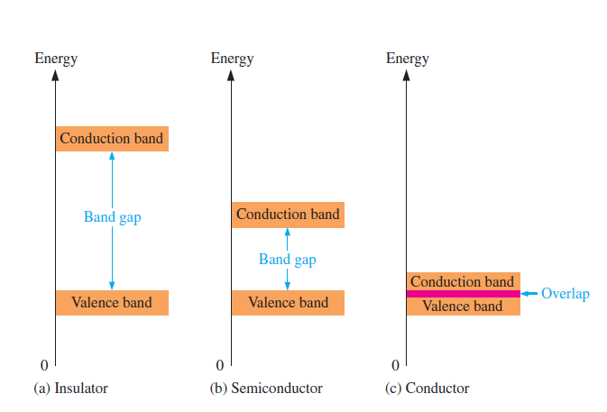
Band Gap
The difference in energy between the valence band and the conduction band is called an energy gap or band gap.
This is the amount of energy that a valence electron must have in order to jump from the valence band to the conduction band.
Once in the conduction band, the electron is free to move throughout the material and is not tied to any given atom.

Slide 6
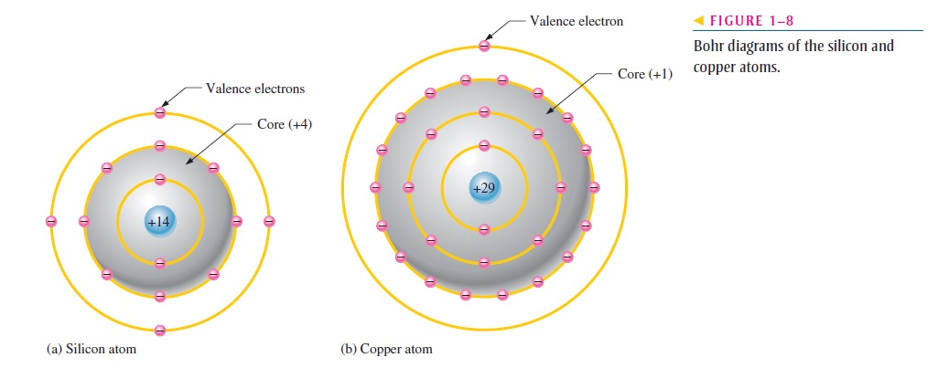
Comparison of a Semiconductor Atom to a Conductor Atom
core of the silicon atom has a net charge of +4 (14 protons - 10 electrons)
the core of the copper atom has a net charge of +1 (29 protons 28 electrons).
The core includes everything except the valence electrons
valence electron in the copper atom “feels” an attractive force of +1 compared to a valence electron in the silicon atom which “feels” an attractive force of +4.

Slide 7
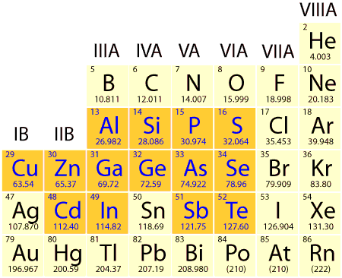

Slide 8
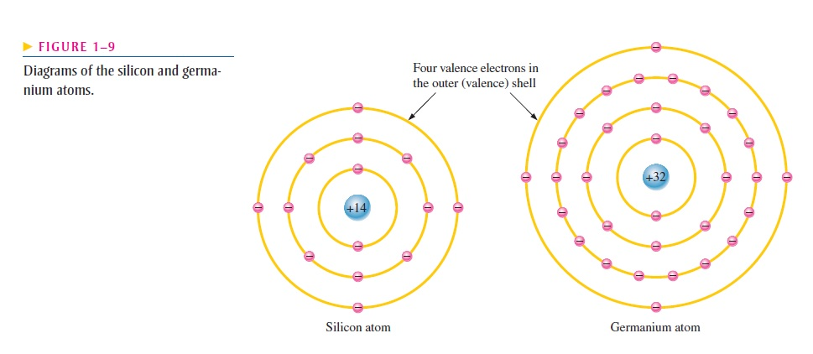
Silicon and Germanium
Notice that both silicon and germanium have the characteristic four valence electrons.
the germanium valence electrons are at higher energy levels than those in silicon and, therefore, require a smaller amount of additional energy to escape from the atom.
This property makes germanium more unstable at high temperatures

Slide 9
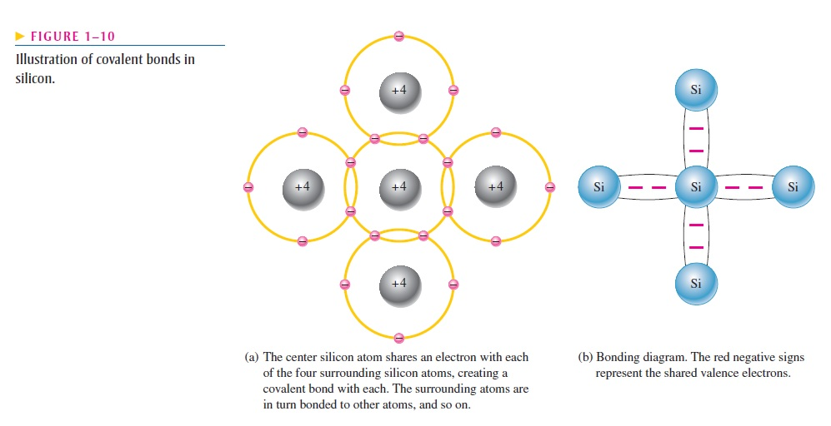
Covalent Bond in Silicon Atom
Covalent bonding in an intrinsic silicon crystal is shown in Figure 1–11. An intrinsic crystal is one that has no impurities. Covalent bonding for germanium is similar because it also has four valence electrons.

Slide 10
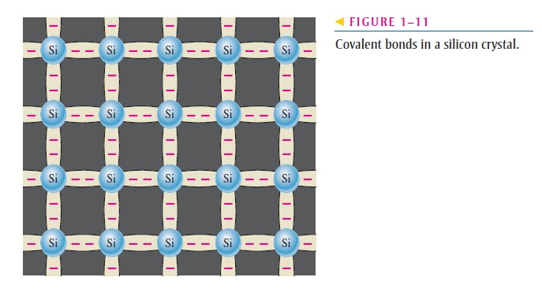

Slide 11
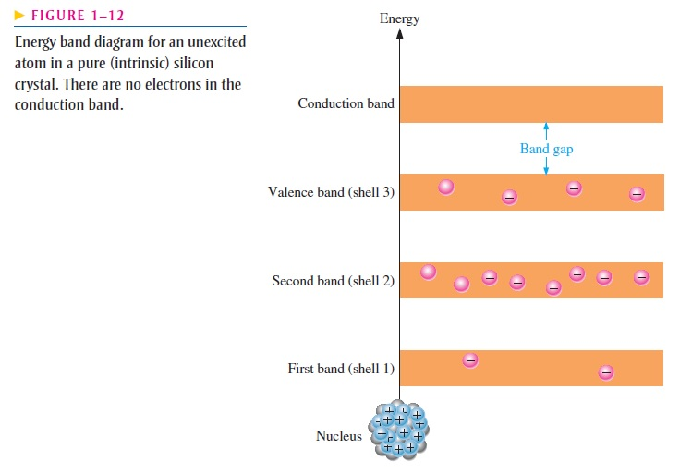
CURRENT IN SEMICONDUCTORS
Figure 1–12 shows the energy band diagram for an unexcited (no external energy such as heat) atom in a pure silicon crystal.This condition occurs only at a temperature of absolute 0 Kelvin.

Slide 12
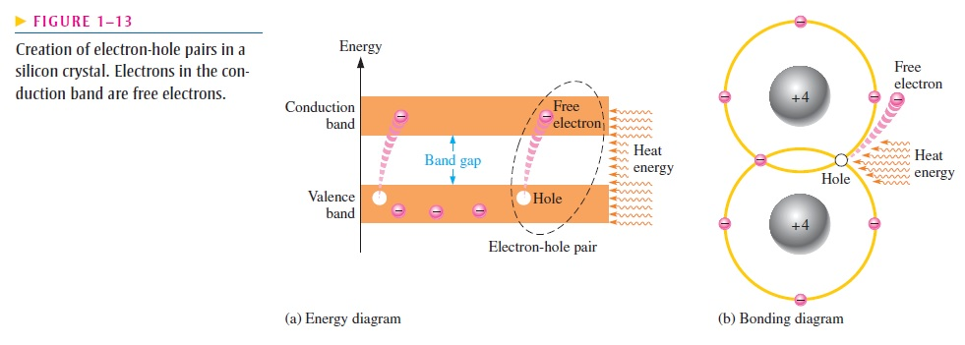
Conduction Electrons and Holes
An intrinsic (pure) silicon crystal at room temperature has sufficient heat (thermal) energy for some valence electrons to jump the gap from the valence band into the conduction band, becoming free electrons. Free electrons are also called conduction electrons.
When an electron jumps to the conduction band, a vacancy is left in the valence band
within the crystal. This vacancy is called a hole.
Recombination occurs when a conduction-band electron loses energy and falls back into a hole in the valence band.

Slide 13
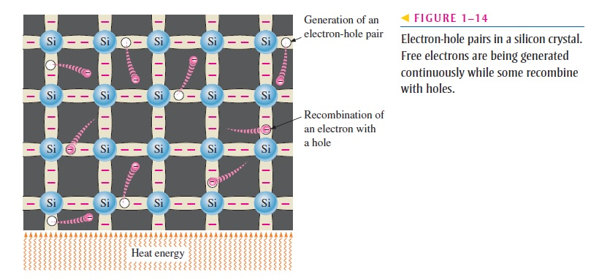

Slide 14
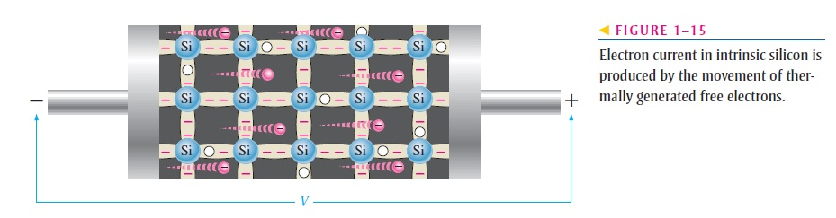
Electron Current
When a voltage is applied across a piece of intrinsic silicon, as shown in Figure 1-15, the thermally generated free electrons in the conduction band, which are free to move randomly in the crystal structure, are now easily attracted toward the positive end. This movement of free electrons is one type of current in a semiconductive material and is called electron current.

Slide 15
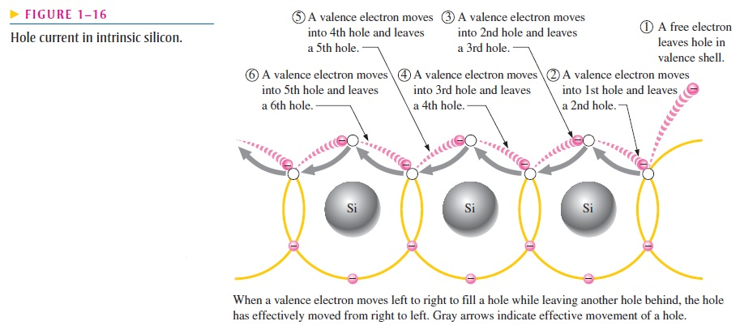
Hole Current

Slide 16
Doping
Since semiconductors are generally poor conductors, their conductivity can be drastically increased by the controlled addition of impurities to the intrinsic (pure) semiconductive material. This process, called doping.
Two categories of impurities are n-type and p-type.

Slide 17
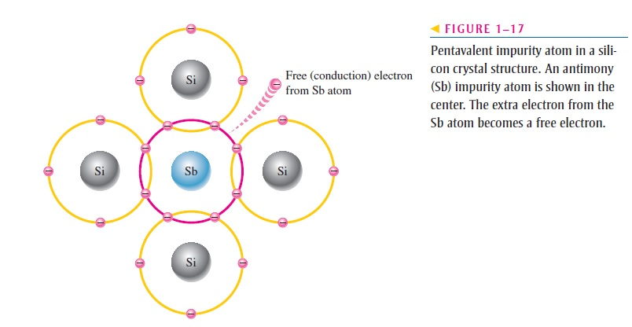
N-Type Semiconductor
To increase the number of conduction-band electrons in intrinsic silicon, pentavalent impurity atoms are added. These are atoms with five valence electrons such as arsenic (As), phosphorus (P), bismuth (Bi), and antimony (Sb).
Since most of the current carriers are electrons, silicon (or germanium) doped with pentavalent atoms is an n-type semiconductor (the n stands for the negative charge on an electron). The electrons are called the majority carriers in n-type material

Slide 18
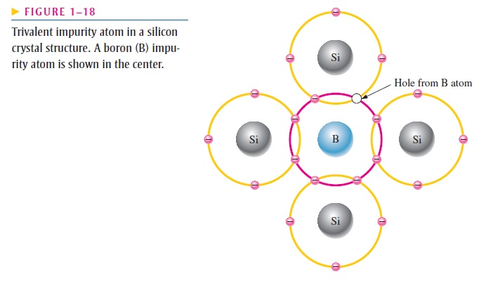
P-type Semiconductor
To increase the number of holes in intrinsic silicon, trivalent impurity atoms are added. These are atoms with three valence electrons such as boron (B), indium (In), and gallium (Ga)
The holes are the majority carriers in p-type material. Although the majority of current carriers in p-type material are holes, there are also a few conduction-band electrons that are created when electron-hole pairs are thermally generated. These conduction-band electrons are not produced by the addition of the trivalent impurity atoms.

